Slide 1
European Rail Tour
My Thoughts and Experiences
Samuel Fiorella

Slide 2
My Experience
Visited UK, France, & Italy for 10 days in December 2017
  Studied their railway systems
  Surveyed passengers about their experiences
  Compared experiences – Europe vs (prior) USA

Slide 3
Compare and Contrast
American vs. European Railway Systems

Slide 4
AMTRAK – A Skeletal Network
Cincinnati: 6 trains/week at late night departures¹
  3 eastbound towards Washington/New York
  3 westbound towards Chicago
  Fairly indicative of most of the rest of the USA
Northeast Corridor
  US’s most heavily travelled
  Has majority travel share between DC/Philadelphia/NY/Boston²
  Undergoing upgrades to raise max speed to 186 mph³

Slide 5
AMTRAK – A Skeletal Network
72% of revenue track owned by private freight railroads⁴
  “On loan”
  Corporations prioritize their larger, slower trains
    Can lead to delays

Slide 6
National Rail (UK)
Amalgamation of operators in England, Wales, and Scotland⁵
  Includes London Underground/Overground/Docklands Light Railway
Survey – small delays often cause system-wide delays
  Passengers upset with weather-related delays
  Issues not as prevalent near London

Slide 7
SNCF & RATP (France)
State-owned French rail service
SNCF operates most regional, all interurban, and all high-speed (TGV) services⁶
RATP operates Paris Métro, Paris trams, and Paris commuter rail (RER) services⁷
Survey – Generally fast and on time
  But during strikes, entire rail network affected
    Service significantly reduced

Slide 8
Trenitalia (Italy)
State-owned Italian rail service⁸
  Operates regional, intercity, and high-speed services
Survey – almost like 2 different systems
  Cutoff either Rome/Naples
  North has better & more reliable service
  South has sparse, often late service

Slide 9
Engineering Hurdles
European Railway Advances

Slide 10
Thames Tunnel
First tunnel under a navigable river (1843)⁹
Built by Brunel to carry cargo without stopping shipping
  Invented tunneling shield
    Cage around miners was advanced
    Bricklayers would build wall behind cage
Today still in use by London Overground

Slide 11
Channel Tunnel
Connects England to France & rest of Europe
31.5 miles long¹⁰
  23.5 miles of which is underwater
Similar technology to Thames Tunnel – TBM¹¹
  Now all mechanical
    Cutter head rotates & chips away at rock
    Pushes itself forwards against wall it places

Slide 12
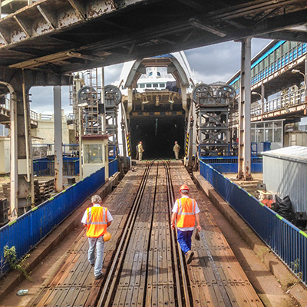
Strait of Messina
Separates Sicily from mainland Italy¹²
Bridge not feasible
  Wide – 2 mi at closest point
  Deep – 300 ft maximum
  Seismologically and volcanically active
Trains board ferries to cross¹³

Slide 13
Lyon – Turin HSR
Will bridge gap (Alps) between France and Italy’s high-speed railway systems¹⁴
Includes 57-km long tunnel under Alps
  One of the longest rail tunnels in the world
Reduces travel time from 4 hours to 2 hours
  Paris to Turin in 4 hours – down from 7

Slide 14
Conclusions
European railway travel does have its shortcomings, but the skeletal state of AMTRAK seems to show that the US can do better when it comes to railways.
The engineering hurdles presented show that the seemingly impossible can be solved using a bit of ingenuity, which is needed to bring the US’s rail system into the 21st century.

Slide 15
References
https://www.amtrak.com/cardinal-train
https://www.theatlas.com/charts/4keTIuOXl
https://www.alstom.com/avelia-liberty-innovation-and-proven-design-very-high-speed
https://www.amtrak.com/national-facts
http://www.nationalrail.co.uk/
https://www.sncf.com/sncv1/en/passengers
https://www.ratp.fr/en
http://www.trenitalia.com/tcom-en
http://www.brunel-museum.org.uk/history/the-thames-tunnel/
https://www.eurostar.com/us-en/travel-info/the-chunnel
http://www.railsystem.net/tunnel-boring-machine-tbm/
https://www.britannica.com/place/Sicily
https://blog.eurail.com/sicily-train-ferry/
https://www.globalmasstransit.net/archive.php?id=18874

